Slide 1
Classifying Songs Into Genres by Lyrics
By Sebastien Perre and Opara Anita

Slide 2
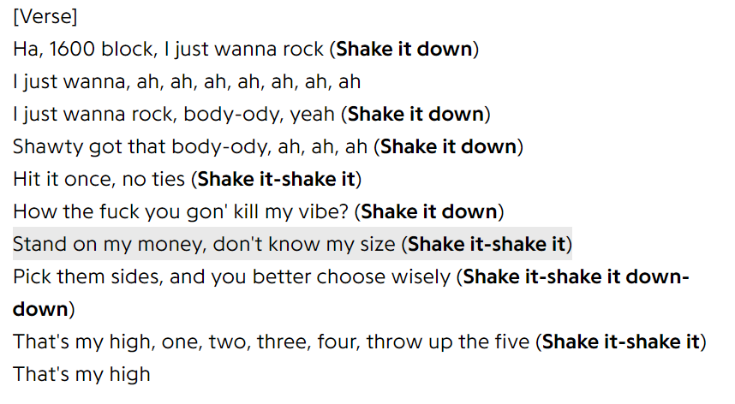
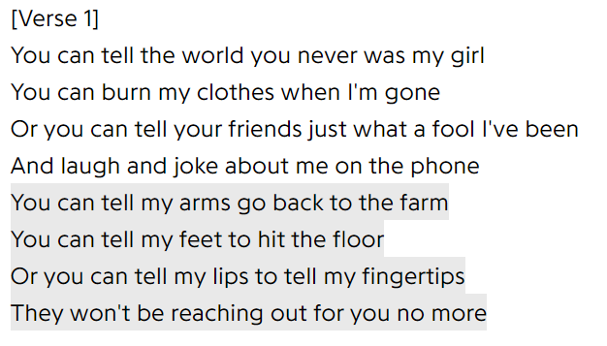
Problem we are trying to solve
The problem we are trying to solve is classifying songs into different genres based on lyrics.
Just Wanna Rock - Lil Uzi Vert - Rap
Achy Breaky Heart - Billy Ray Cyrus - Country
Courtesy: https://genius.com/Lil-uzi-vert-just-wanna-rock-lyrics
Courtesy: https://genius.com/Billy-ray-cyrus-achy-breaky-heart-lyrics

Slide 3
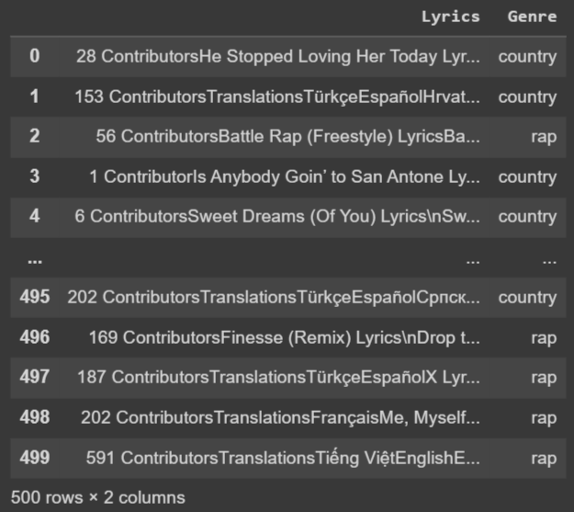
Key Insights about the data
We have 250 country songs and 250 rap songs to train from, gathered from the genius api charts and manually entered song names.
The data song lyrics followed by the genre of the song
The data.csv file generated contains 2 columns: Lyrics and Genre

Slide 4
Sentimental Differences in Country and Rap
The sentimental score of the country songs was 0.110879
The sentimental score of the rap songs was 0.00409
As we can see, the country song sentimental score is around 27 times larger than the rap score. This makes sense since rap songs have more vulgar language such as swear words while country has more nuance language.
9779951127.109779951127.1097799511

Slide 5
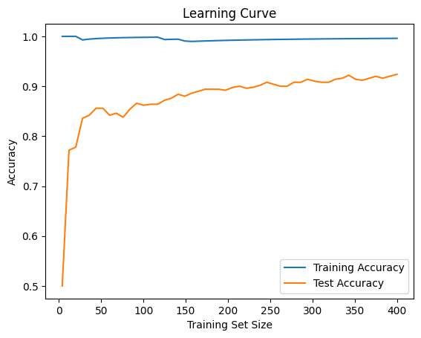
Our Model
Our model uses Multinomial Naive Bayes with alpha = 0.01 and fit_prior = True which gives us around 92% accuracy in identifying country and rap songs. The learning curve is not overfitting since we have a good accuracy.

Slide 6
Problems we encountered
Problems with virtual machines and genius’s API
Timeout issues with API Requests
Not enough songs on the chart so we had to manually input song names
Artifacts in the data such as contributors and embeds

Slide 7
Improvements to our Model
Remove artifacts (remove contributions and embeds in the lyrics data), which might help improve accuracy
Create a multilabel classification model since most songs have more than 1 genre associated with them
Instead of a binary model create a multi-classification model with rap, rock and country since they don’t have much overlap with each other

